Slide 1
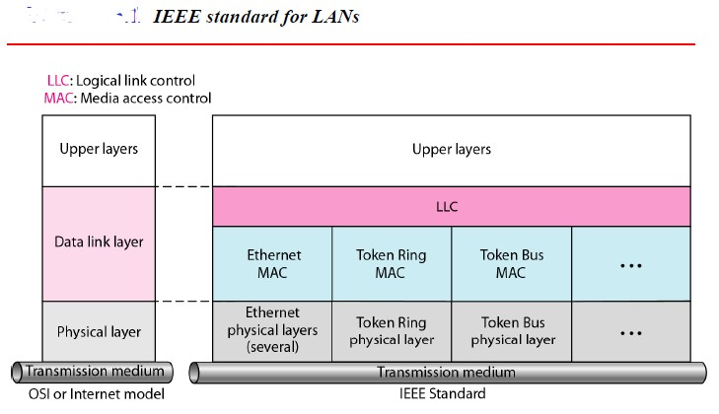
Chapter 8 Wired LANs: Ethernet
LAN is a computer network that is designed for a limited geographic area such as a building or a campus. In 1985, the Computer Society of the IEEE started a project, called Project 802, to set standards to enable intercommunication among equipment from a variety of manufacturers.Project 802 does not seek to replace any part of the OSI or the Internet model. Instead, it is a way of specifying functions of the physical layer and the data link layer of major LAN protocols.
The IEEE has subdivided the data link layer into two sub-layers: logical link control (LLC) and media access control (MAC).
Figure (1)
Logical Link Control (LLC)
Data link control handles framing, flow control, and error control. In IEEE Project 802, flow
control, error control, and part of the framing duties are collected into one sublayer called the
logical link control. Framing is handled in both the LLC sublayer and the MAC sublayer. The
1

Slide 2
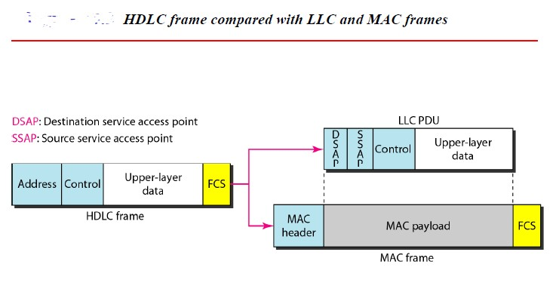
LLC provides one single data link control protocol for all IEEE LANs. In this way, the LLC is different from the media access control sublayer, which provides different protocols for different LANs. A single LLC protocol can provide interconnectivity between different LANs because it makes the MAC sublayer transparent. Figure (1) shows one single LLC protocol serving several MAC protocols.
Framing LLC defines a protocol data unit (PDU) that is somewhat similar to that of HDLC (High-level Data Link Control). The header contains a control field like the one in HDLC; this field is used for flow and error control. The two other header fields define the upper-layer protocol at the source and destination that uses LLC. These fields are called the destination service access point (DSAP) and the source service access point (SSAP). The other fields defined in a typical data link control protocol such as HDLC are moved to the MAC sublayer. In other words, a frame defined in HDLC is divided into a PDU at the LLC sublayer and a frame at the MAC sublayer, as shown in Figure (2).
Figure (2)
FCS frame check sequence, the FCS field is 4 bytes long and contains a CRC-32 error detection sequence.
Media Access Control (MAC)
IEEE Project 802 has created a sublayer called media access control that defines the specific
access method for each LAN. For example, it defines CSMA/CD as the media access method for Ethernet LANs and the tokenpassing method for Token Ring and Token Bus LANs. As we discussed in the previous section, part of the framing function is also handled by the MAC
layer. In contrast to the LLC sublayer, the MAC sublayer contains a number of

Slide 3
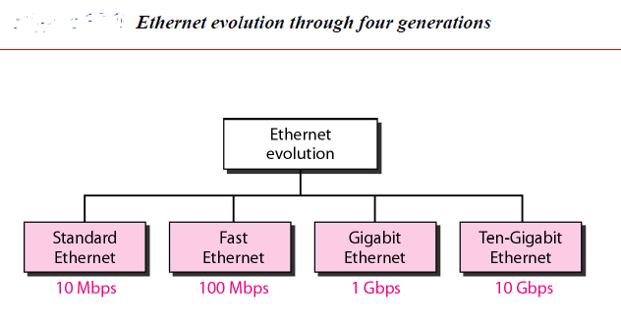
distinctmodules; each defines the access method and the framing format specific to the correspondingLAN protocol.
CSMA/CDcarrier sense multiple access with collision detection
STANDARD ETHERNET
The original Ethernet was created in 1976 at Xerox’sPalo Alto Research Center (PARC). Since then, it hasgone through four generations. We briefly discuss theStandard (or traditional) Ethernet in this section.
MAC Sublayer
In Standard Ethernet, the MAC sublayer governs the operation of the access method. Italso
frames data received from the upper layer and passes them to the physical layer.
Frame Format
The Ethernet frame contains seven fields:
Preamble: The first field of the 802.3 frame contains 7 bytes (56 bits) of alternating 0s and 1s that alerts the receiving system to the coming frame and enables it to synchronize its input timing. The pattern provides only an alert and a timing pulse. The 56-bit pattern allows the stations to miss some bits at the beginning of the frame. The preamble is actually added at the physical layer and is not (formally)part of the frame.
SFD: Start frame delimiter, the second field (l byte: 10101011) signals the beginning of the frame. The SFD warns the station or stations that this is the last chance for
synchronization. The last 2 bits is 11 and alerts the receiver that the next field is the
destination address.
DA: Destination address, the DA field is 6 bytes and contains the physical address of the destination station or stations to receive the packet.

Slide 4
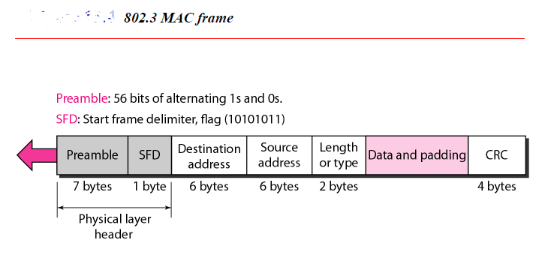
SA: Source address, the SA field is also 6 bytes and contains the physical address of the sender of the packet.
Length or type of protocol data unit (PDU), this field is defined as a type field or length field. The original Ethernet used this field as the type field to define the upper-
layer protocol using the MAC frame. The IEEE standard used it as the length field to
define the number of bytes in the data field. Both uses are common today.
Upper-layer data, this field carries data encapsulated from the upper-layer protocols. It is a minimum of 46 and a maximum of 1500 bytes, as we will see later.
CRC, the last field contains error detection information, in this case a CRC-32.
Ethernet does not provide any mechanism for acknowledging received frames, making itwhat is known as an unreliable medium. Acknowledgments must be implemented at the higher layers. The format of the MAC frame is shown in Figure (3).
Figure (3)
Frame Length
Ethernet has imposed restrictions on both the minimum and maximum lengths of a frame, as
shown in Figure (4).

Slide 5
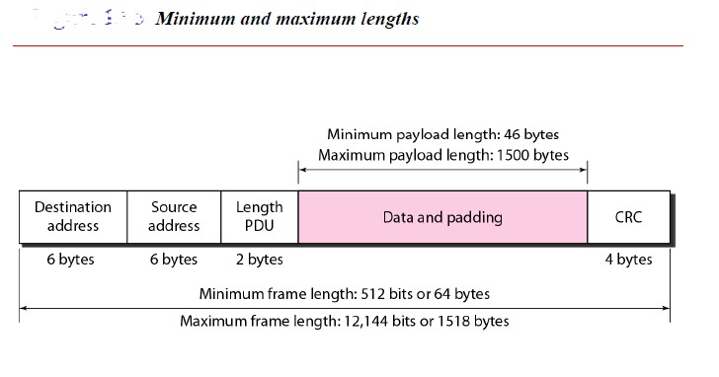
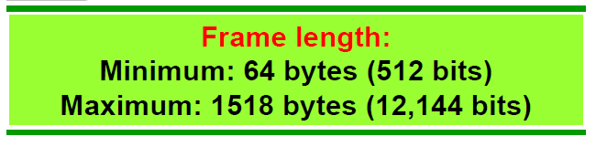
Figure (4)
An Ethernet frame needs to have a minimum length of 512 bits or 64 bytes. Part of this length is the header and the trailer. If we count 18 bytes of header and trailer (6 bytes of source address, 6 bytes of destination address, 2 bytes of length or type, and 4 bytes of CRC), then the minimum length of data from the upper layer is 64 - 18 = 46 bytes. If the upper-layer packet is less than 46 bytes, padding is added to make up the difference.
The standard defines the maximum length of a frame (without preamble and SFD field) as 1518 bytes. If we subtract the 18 bytes of header and trailer, the maximum length of the
payload is 1500 bytes. The maximum length restriction has two historical reasons. First, memory was very expensive when Ethernet was designed: a maximum length restriction helped to reduce the size of the buffer. Second, the maximum length restriction prevents one station from monopolizing the shared medium, blocking other stations that have data to send.
Addressing
Each station on an Ethernet network (such as a PC, workstation, or printer) has its own
network interface card (NIC). The NIC fits inside the station and provides the station with a 6-byte physical address. As shown in Figure (5), the Ethernet address is 6 bytes (48 bits), normally written in hexadecimal notation, with a colon between the bytes.

Slide 6
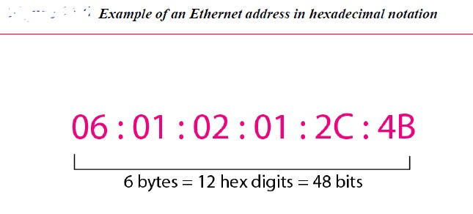
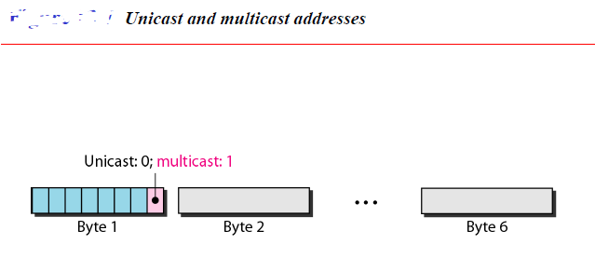
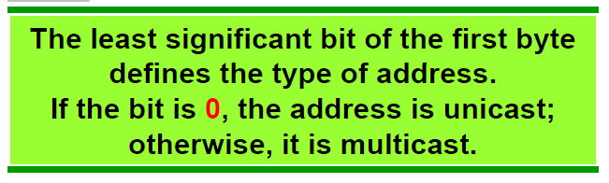
Figure (5)
Unicast, Multicast, and Broadcast Addresses. A source address is always a unicast address-the frame comes from only one station. The destination address, however, can be unicast,
multicast, or broadcast. Figure (6) shows how to distinguish a unicast address from a
multicast address. If the least significant bit of the first byte in a destination address is 0, the address is unicast; otherwise, it is multicast.
Figure (6)
A unicast destination address defines only one recipient; the relationship betweenthe sender and the receiver is one-to-one. A multicast destination address defines a groupof addresses; the relationship between the sender and the receivers is one-to-many.The broadcast address is a special case of the multicast address; the recipients areall the stations on the LAN. A broadcast destination address is forty-eight 1s.

Slide 7
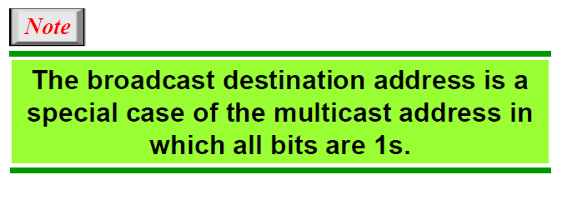
Example 13.1
Define the type of the following destination addresses: a. 4A:30:10:21:1O:1A
b. 47:20:1B:2E:08:EE
c. FF:FF:FF:FF:FF:FF
Solution
To find the type of the address, we need to look at the second hexadecimal digit from the left. If itis even, the address is unicast. If it is odd, the address is multicast. If all digits are F's, the addressis broadcast. Therefore, we have the following:
This is a unicast address because A in binary is 1010 (even).
This is a multicast address because 7 in binary is 0111 (odd).
This is a broadcast address because all digits are F's.
The way the addresses are sent out on line is different from the way they are writteninhexadecimal notation. The transmission is left-to-right, byte by byte; however, foreach byte, the least significant bit is sent first and the most significant bit is sent last.
This means that the bit that defines an address as unicast or multicast arrives first at the receiver.
Physical Layer
The Standard Ethernet defines several physical layer implementations; four of the most
common, are shown in Figure (7).

Slide 8
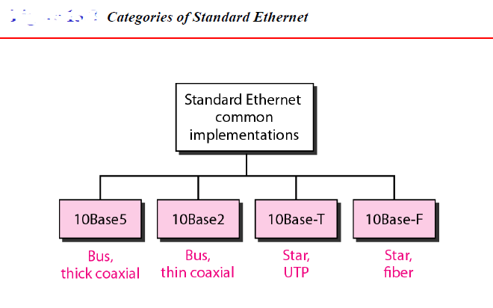
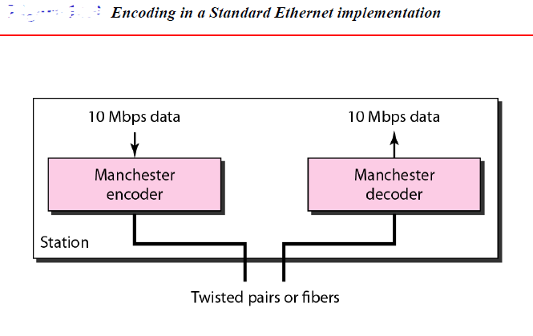
Figure (7)
Encoding and Decoding
All standard implementations use digital signaling (baseband) at 10 Mbps. At the sender,data
are converted to a digital signal using the Manchester scheme; at the receiver, thereceivedsignal is interpreted as Manchester and decoded into data. Manchester encoding is self- synchronous, providing a transition at each bit interval. Figure (8) shows the encoding scheme for Standard Ethernet.
Figure (8)
10Base5: Thick Ethernet
The first implementation is called 10Base5, thick Ethernet, or Thicknet. The nicknamederives
from the size of the cable, which is roughly the size of a garden hoseand too stiff to bend with your hands. 10Base5 was the first Ethernet specification touse a bus topology with an external
transceiver (transmitter/receiver) connected via atap to a thick coaxial cable. Figure (9) shows
a schematic diagram of a 10Base5implementation.

Slide 9
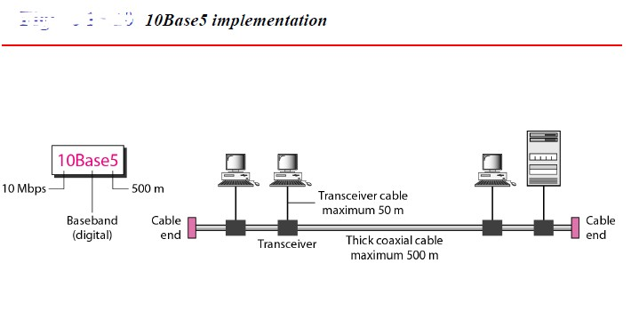
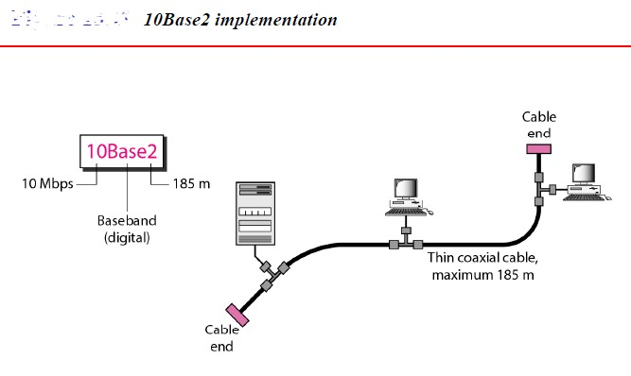
Figure (9)
The transceiver is responsible for transmitting, receiving, and detecting collisions.The transceiver is connected to the station via a transceiver cable that provides separatepaths for sending and receiving. This means that collision can only happen in thecoaxial cable.
The maximum length of the coaxial cable must not exceed 500 m, otherwise, thereis excessive degradation of the signal. If a length of more than 500 m is needed, up tofive
segments, each a maximum of 500-meter, can be connected using repeaters.
10Base2: Thin Ethernet
The second implementation is called 10Base2, thin Ethernet, or Cheapernet. 10Base2also uses
a bus topology, but the cable is much thinner and more flexible. The cable canbe bent to pass very close to the stations. In this case, the transceiver is normally part ofthe network interface card (NIC), which is installed inside the station. Figure (10)shows the schematic diagram of a 10Base2 implementation.
Figure (10)
Note that the collision here occurs in the thin coaxial cable. This implementation ismore cost effective than 10Base5 because thin coaxial cable is less expensive than thickcoaxial and the
tee connections are much cheaper than taps. Installation is simplerbecause the thin coaxial

Slide 10
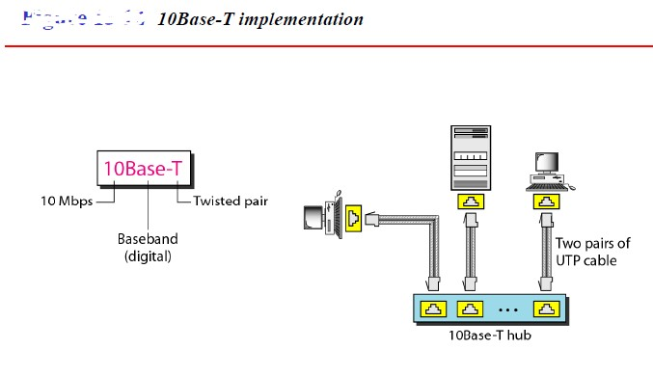
cable is very flexible. However, the length of each segmentcannot exceed 185 m (close to 200
m) due to the high level of attenuation in thin coaxialcable.
10Base-T: Twisted-Pair Ethernet
The third implementation is called 10Base-T or twisted-pair Ethernet. 10Base-T usesa
physical star topology. The stations are connected to a hub via two pairs of twistedcable, as shown in Figure (11).Note that two pairs of twisted cable create two paths (one for sending and one forreceiving) between the station and the hub. Any collision here happens in the hub. Compared to 10Base5 or 10Base2, we can see that the hub actually replaces the coaxialcable as far as a collision is concerned. The maximum length of the twisted cable hereis defined as 100 m, to minimize the effect of attenuation in the twisted cable.
Figure (11)
10Base-F: Fiber Ethernet
Although there are several types of optical fiber 10-Mbps Ethernet, the most common is
called 10Base-F. 10Base-F uses a star topology to connect stations to a hub. The stationsare connected to the hub using two fiber-optic cables, as shown in Figure (12).
10

Slide 11
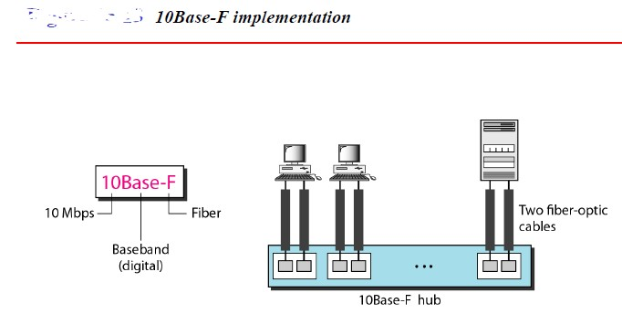
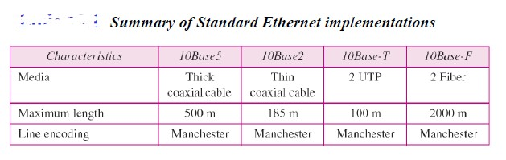
Figure (12)
11

